Slide 1

Introduction to Python
Optimization lab
2021-11-26

Slide 2


Content
Compiler vs. Interpreter
Basic types.
Variables and Expressions.
Classes and Objects.
Methods and Functions.
Iterables.
String operations.
CoLab.

Slide 3
Why Python?
Compiler:
Translates the whole code or program into computer language.
Execution time is far faster than interpreters.
Relatively hard to understand and debug.
Rigid structure.
C, Java.
Interpreter:
Translates code line by line.
Easier to understand and debug.
Execution time is longer.
More flexible.
Python, JavaScript.

Slide 4
Basic Types and Conversion
Integer:
class int
-10, 0, 10…
Float:
class float
1.3, -24.05, 0.0
Bool:
class bool
True, False
String:
class str
‘A’, ‘fjdakA54’, ’45’
Integer -> Float:
float(10) -> 10.0
10 * 1. -> 10.0
Float -> Integer:
int(10.9) -> 10
Bool -> Integer:
int(True) -> 1
int(False) -> 0
Integer -> Bool:
bool(0) -> False
bool(2) -> True

Slide 5


Variables and Expressions
Variable:
Location in memory (RAM).
Can be of any type (int, bool, float, etc.).
Expressions:
Operations to be executed.
Can include variables and/or constants.

Slide 6
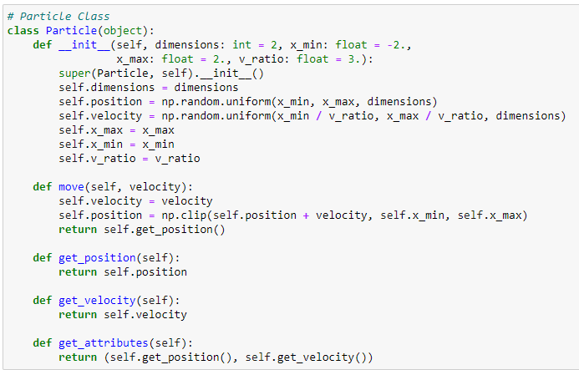

Classes and Objects
Class:
Collection of data (variables) and methods.
Unique identifier.
Object:
Instance of a class.
Multiple instances of a class.
Everything is an object!

Slide 7
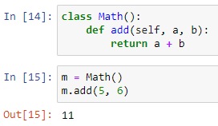
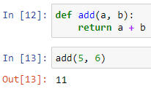
Methods and Functions
Method:
It’s called on an object or instance.
Cannot be accessed outside the object (encapsulation).
It may modify the object’s state.
Function:
Independent, not associated with objects.
Can be called anywhere.

Slide 8
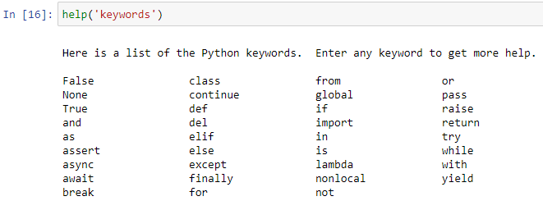
Reserved Keywords
Python is case sensitive!

Slide 9
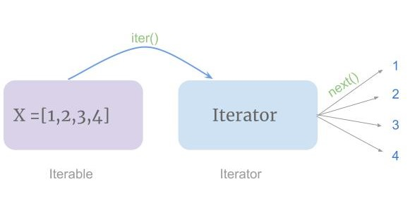
Iterable Objects
Return items one at a time.
Can support indexing.
Strings
Lists
Tuples
Dictionaries
Arrays

Slide 10
String Operations
Concatenation:
‘A’ + ‘B’ -> ‘AB’
Indexing:
Zero-index.
Each character in the sequence (string) has a zero-based index.
Negative indexing.
Slice:
Gets a piece (slice) of the sequence (string).

Slide 11
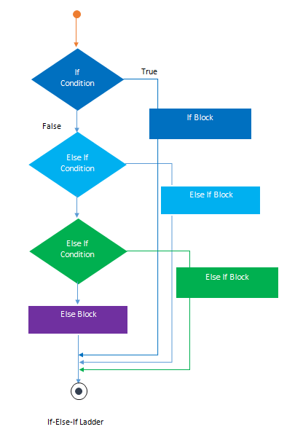
Conditions (if… elif… else)

Slide 12
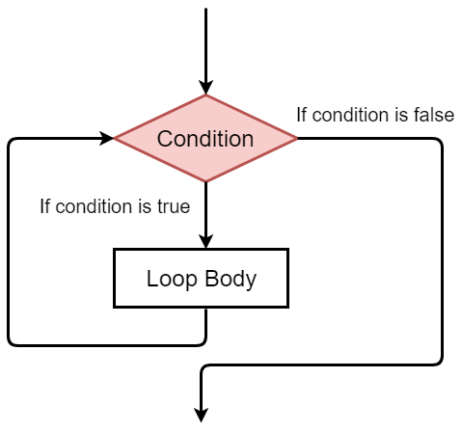
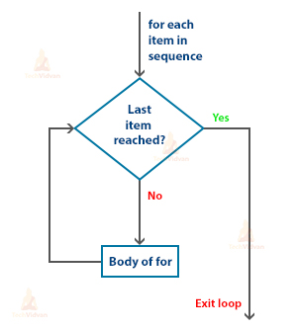
Loops
While loop:
Executes the block as long as a condition is true.
For loop:
Iterates through a sequence (iterable).

Slide 13
Google CoLab
Based on Jupyter Notebook.
Python ready, no need to install anything.
Accessed from the web.
https://colab.research.google.com/

